Slide 1

Developed By: Ramy Atalla, Michael Medina, & Mark Lindo

Slide 5
The Problem We All Face
Everyday thousands of people travel in and out of New York City but more often than not they run into these common problems:
You get to your destination and there is no parking available
You don’t know if your destination will provide parking or if you have to find a parking lot
All the parking lots around your destination seem too expensive

Slide 6
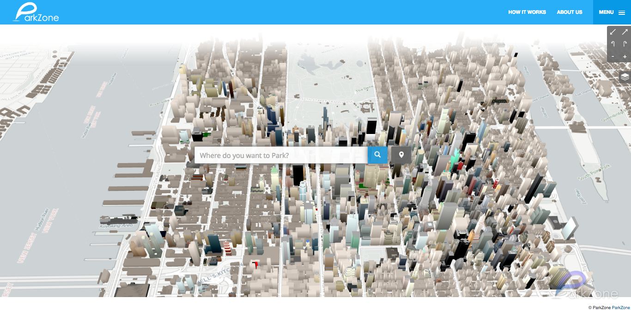
Introducing ParkZone
At a glance, ParkZone is a simple web application that helps the user find parking
Map controls are easy to understand and intuitive
Interface is completely interactable
Clean layout and design

Slide 7
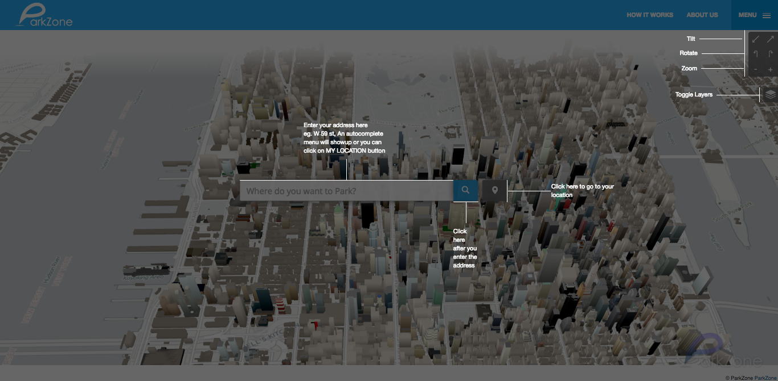
Simple and Easy to Use
Functionality is very straightforward
Type in your destination and ParkZone does the rest
Intuitive map controls and toggles makes seeing what you want easier

Slide 8
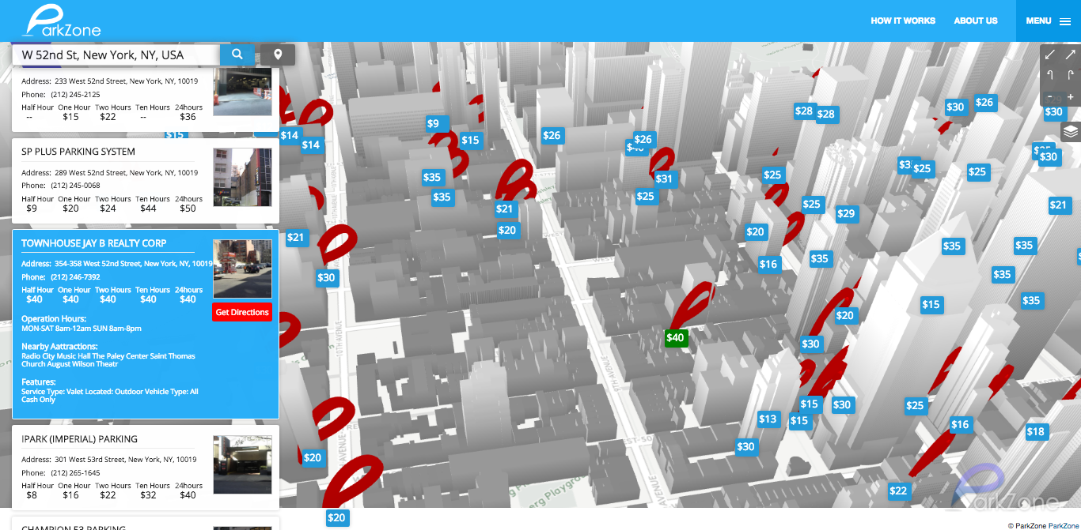
The Information You Want
The data is displayed in a clean and easy to follow format
Information at a glance - map shows the cheapest the garage offers
All the necessary information you might want is there
Address, rates, accessibility and more

Slide 9
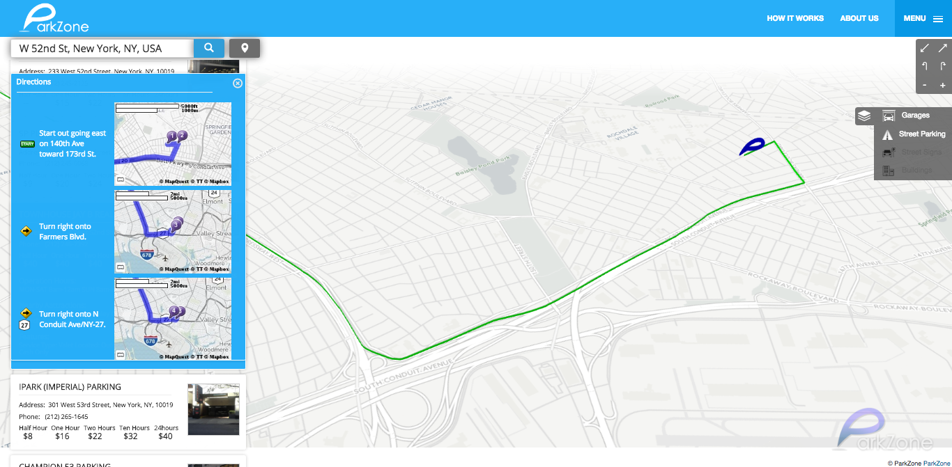
Added Functionality
Toggleable map details to make viewing information easier
Find’s where you are using location services
Directional feature to find out how to get to where you want to go

Slide 10
Traffic Cameras - Can We Use Them?
DOT camera feed was collected from the DOT’s website to provide extra insight to the user
Can you find a parking spot yourself?
Free public cameras are limited to Manhattan
Mostly located on intersections and expressways
153 traffic cameras were used

Slide 11
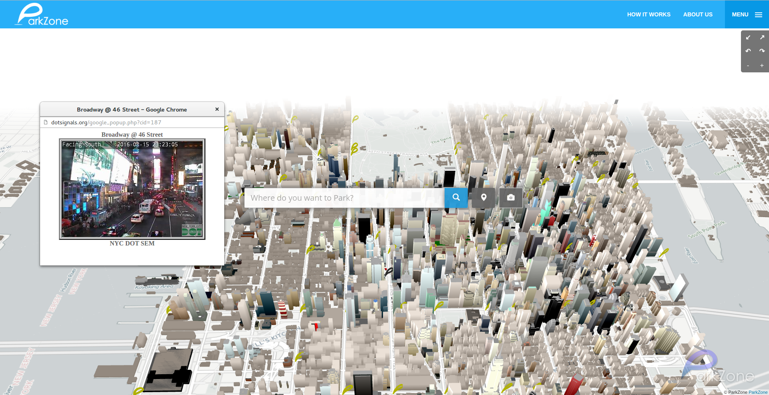
Traffic Cameras
Yellow ParkZone icons represent a traffic camera
Icons are clickable and when clicked video is displayed
This is meant to help the user get an image of traffic and parking spots in the area

Slide 12
The TL;DR
ParkZone is a web application designed to help you find parking
A clean map interface displays parking garages and signs to help you make the best call
Added functionality like plotting a course to your destination makes ParkZone an all inclusive app
ParkZone hopes to push the boundary forward and make you rethink the way a parking assistant application should work

Slide 13
Repository @ https://github.com/ramitix/ParkZone

